Slide 1

How Pit-Stop Time Correlates with Final Position in Formula 1
By: David Kvinikadze

Slide 2

General Information about F1:
There are multiple races each year.
Each car team has two drivers
Racing strategies are hugely depended on Pit Stops.
Pit stops are only designed to fill the gas and change tires.
Every second counts because drivers drive at the speed of 200-350 mph.

Slide 3
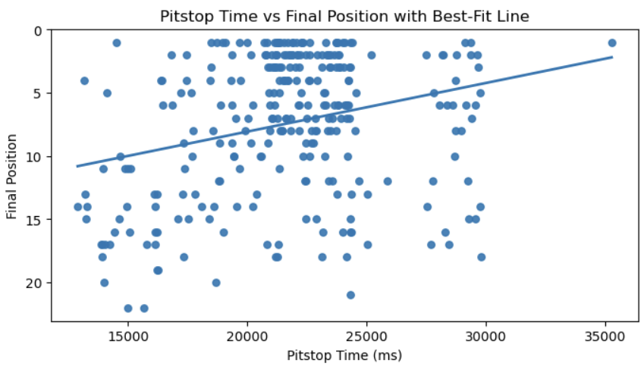
Data organizing steps that led to my findings:
Removing every column except: raceId, pitstop_milliseconds, final position.
I tried to find out if there was a correlation between variables: pitstop_milliseconds, and final position.
I used statistics to prove my point.
Used Scatter plot for visualization

Slide 4
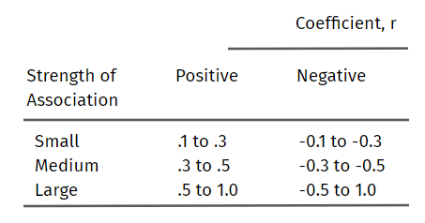
Statistics part:
Found the “Pearson’s r”
R = -0.272
Tested if the finding was statistically significant.
Formula for testing statistical significance:
|r| is > 2/√n
0.272 > 0.12 => statisticaly significant!

Slide 5

What does this information give us?
01
Race car teams should focus on their pitstops strategies
02
Teams could spend more money on their pit stop crew.

Slide 6
Challenges I faced
1.
2.
3.
Figuring out what to do with NAN values in my data
Merging method for Merging Multiple Datasets
Logical steps to prove my hypothesis

Slide 7
Future Work
Observation of variables other than pitstop time
Including driver and their team’s informations

Slide 8

Thank you for your attention!

